Slide 1

Airplane Crash Analysis using PowerBI
RMS
Notes:
Hello everyone, this is Raghunandan. Today I am sharing my part of work in internship of Airplane Crash Analysis using PowerBI. Firstly, let me thank Mentorness for the project of real time scenario and helping me achieve this.

Slide 2

Problem Statement
Conducting a comprehensive analysis of airplane crashes and fatalities spanning from 1908 to 2023
Dataset contains crucial information such as crash dates, locations, operators, flight details, aircraft types, and fatality statistics

Slide 3

Dataset Description
1. Date: Date of the airplane crash.
2. Time: Time of the airplane crash.
3. Location: Location where the airplane crash occurred.
4. Operator: Operator or airline involved in the incident.
5. Flight #: Flight number associated with the incident.
6. Route: Planned route of the flight.
7. AC Type: Aircraft type involved in the crash.
8. Registration: Registration details of the aircraft.
9. cn/ln: Construction or serial number of the aircraft.
10. Aboard: Total number of individuals aboard the aircraft.
11. Aboard Passengers: Number of passengers aboard the aircraft.
12. Aboard Crew: Number of crew members aboard the aircraft.
13. Fatalities: Total fatalities in the incident.
14. Fatalities Passengers: Number of passenger fatalities.
15. Fatalities Crew: Number of crew member fatalities.
16. Ground: Casualties on the ground, if any.
17. Summary: Summary or description of the incident

Slide 4

Data cleaning in powerbi
Cleaning empty/blank rows
Cleaning columns with repeated values
Transposing and checking for same quality values in rows

Slide 5

Project Objectives
1. Temporal Analysis:
- Explore temporal trends in airplane crashes over the years.
- Identify patterns in the frequency and severity of incidents.

Slide 6
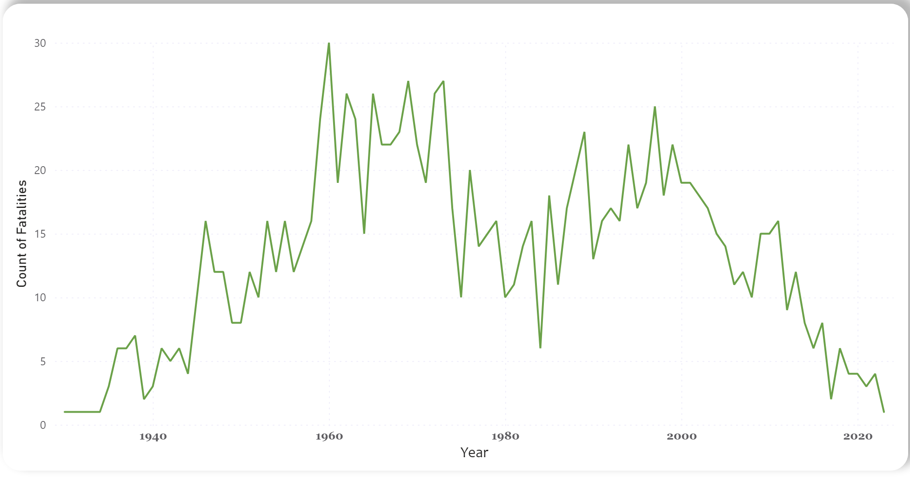

Slide 7
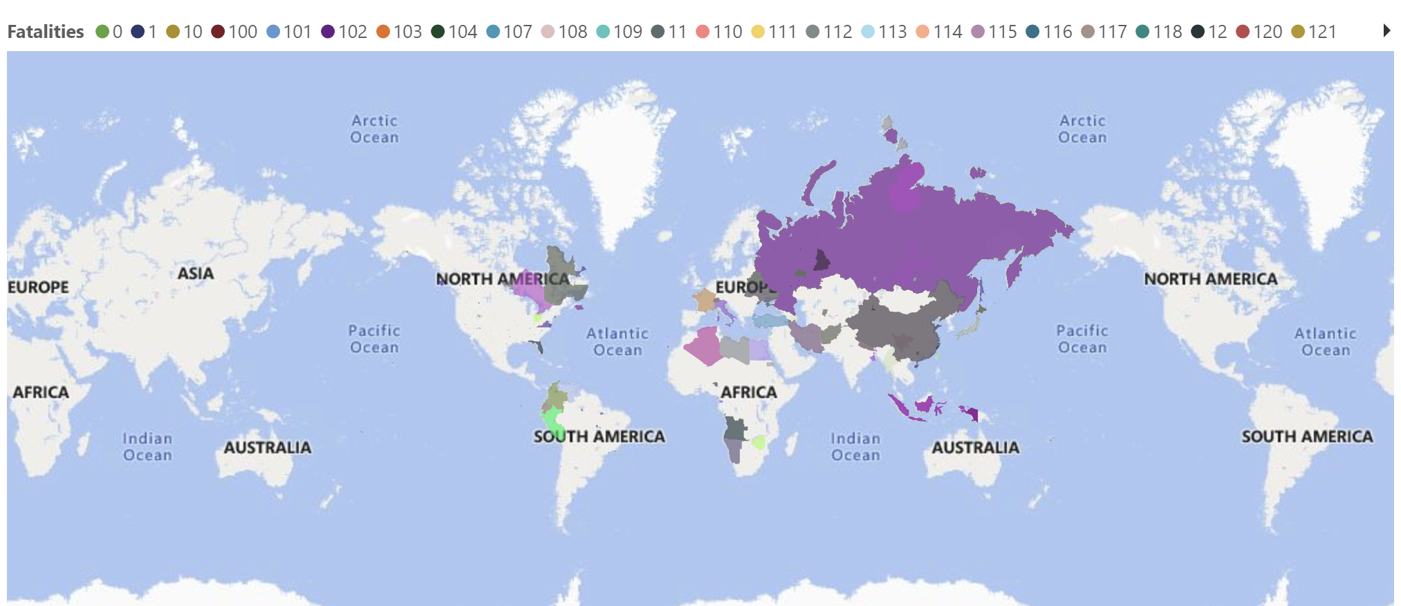
2. Geospatial Analysis

Slide 8
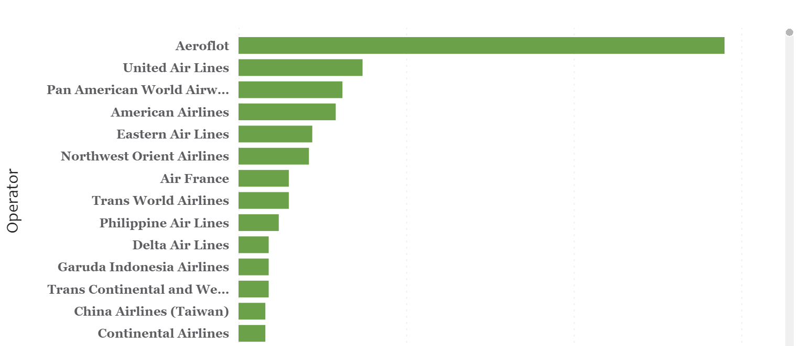
3. Operator Performance

Slide 9
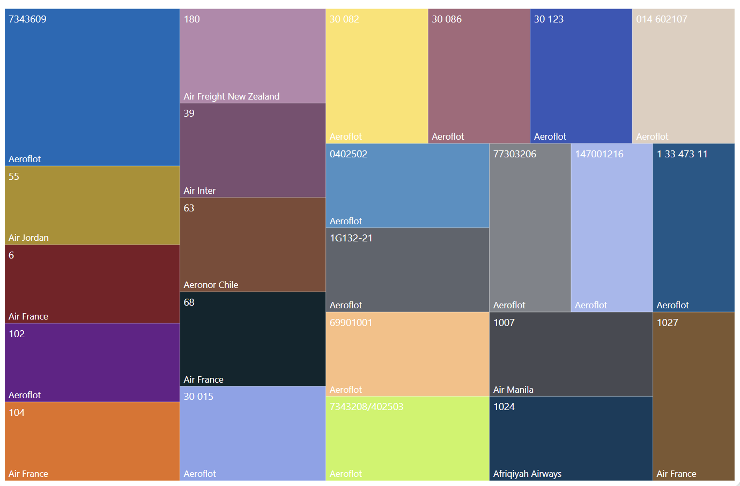
4. Aircraft Analysis

Slide 10
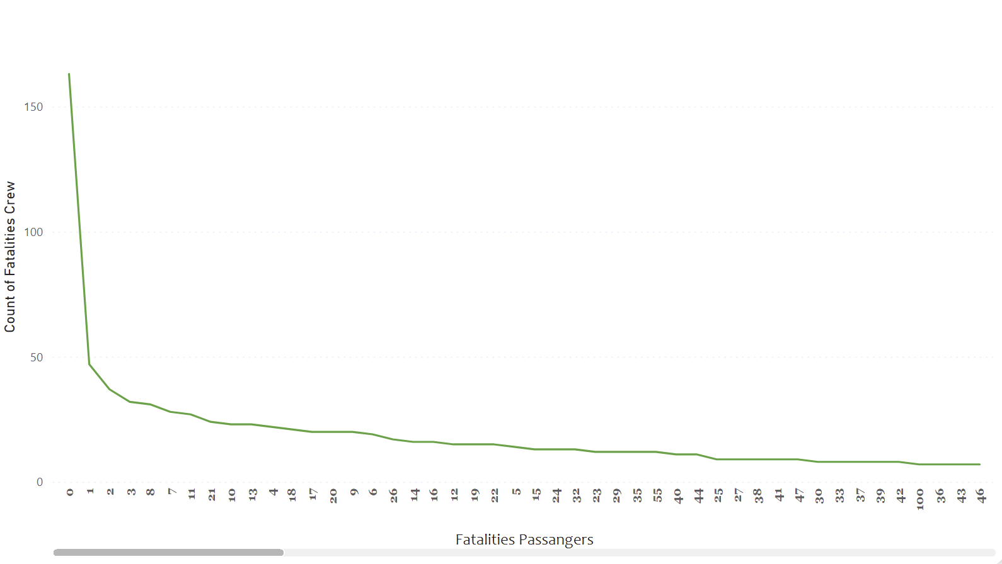
5. Fatality Trends

Slide 11
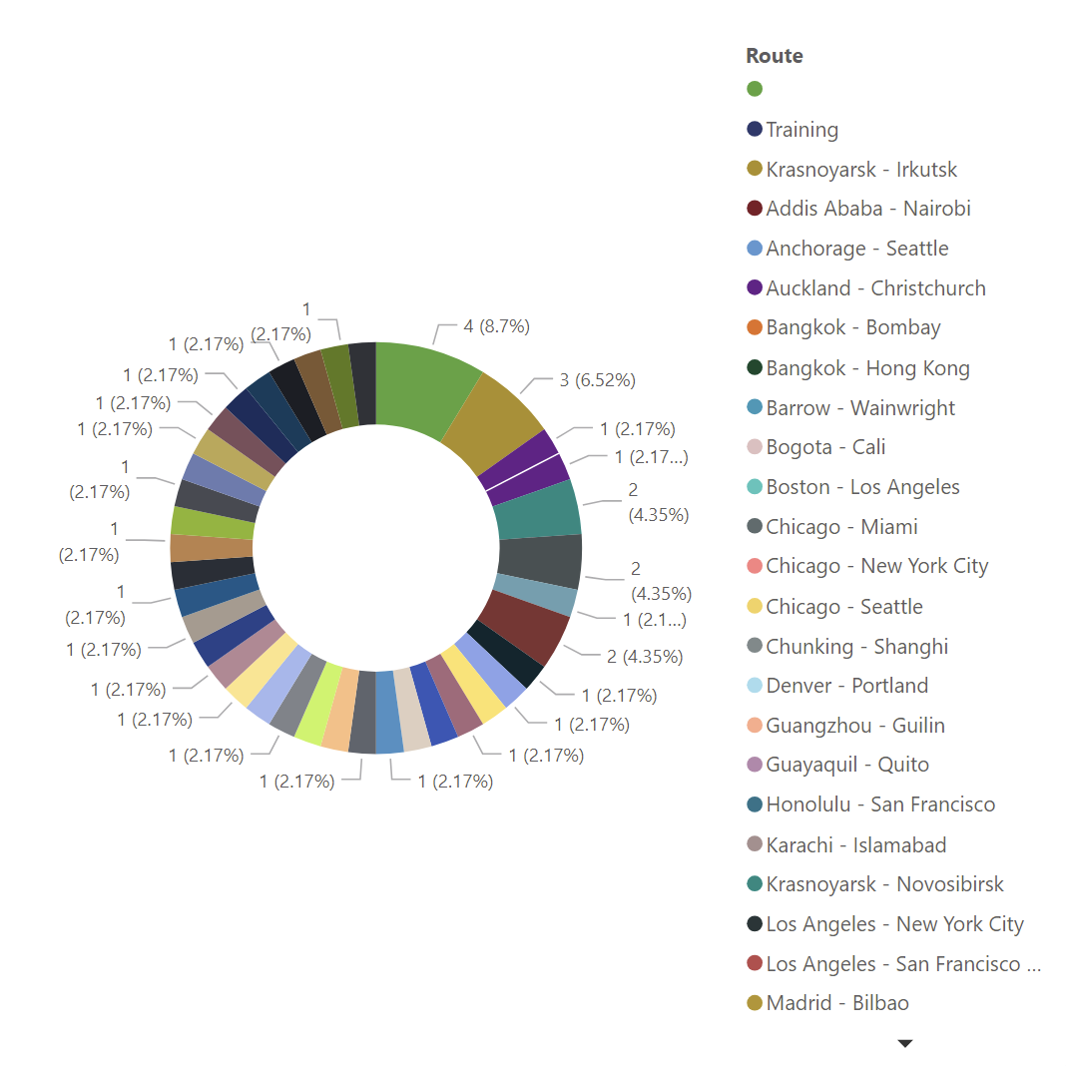
6. Route Analysis

Slide 12
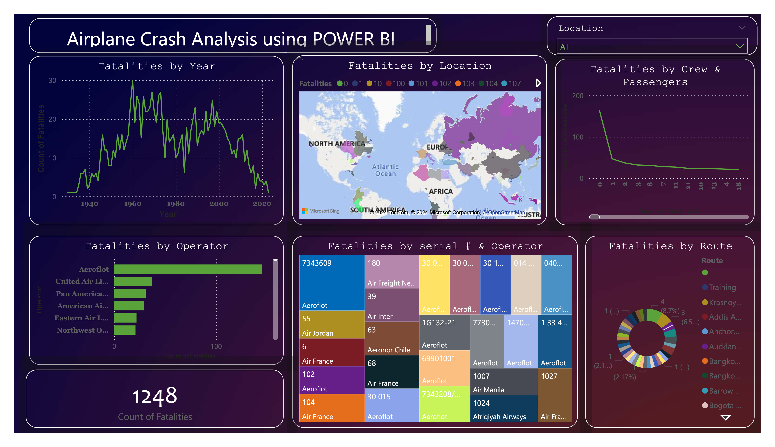

Slide 13


